Slide 1
Multi Alphabet/Image/Number Sequence Learning by Damir Dobric
Gaurav Honnavara Manjunath - 1384178
Harish Palanivel - 1392283
Prajwal Praveen Athkar - 1394663

Slide 2
Objective/Abstract
The evolution of life on Earth has developed the human brain containing the cortex which in the environment processes a series of sensory information and builds temporary memory. This leads to identifying and foretelling information about the previously visualized functions like speech recognition, natural vision, and sequences of information. In real-life situations, the prediction and perception of temporal sequences for sensory inputs are useful/critical. Based on multiple known features of neurons, a theoretical framework has been proposed for sequence learning in the cortex is known as Hierarchical Temporal Memory (HTM) sequence learning. The model using temporal memory can handle varying the sequences by keeping the predictions until valid evidence is available. HTM’s ability to predict future patterns arrive from learning which patterns are likely to follow each other. In scenarios when HTM receives a unique pattern, it compares historically received patterns with the new pattern. As input never repeats in the same fashion, the uniqueness of sequence is critical for recognizing inputs. HTM uses shifting order memory, which enables it to predict using variable-length sequences

Slide 3
Introduction
Medical Science and ML engineers were working on the understanding of cortex for temporal pattern recognition.
HTM (Hierarchical Temporal Memory) has been proposed for sequence learning.
HTM is a biomimetics model based on the principle of memory predictions.

Slide 4
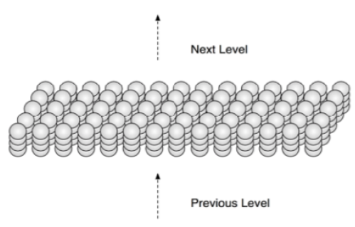
Introduction – SDRs (Sparse Distributed Representations)
HTM’s language is (Sparse Distributed Representations) SDRs of input patterns
Generates SDRs internally to give fixed number of bits
The bits are given semantic meaning

Slide 5
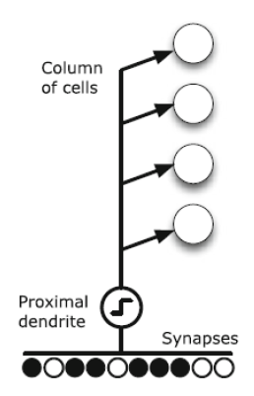
Introduction – PDS (Proximal Dendrite Segments) &
PDS with synapses are representated by small black circles
Based on active input bits, feedforward input activates a column

Slide 6
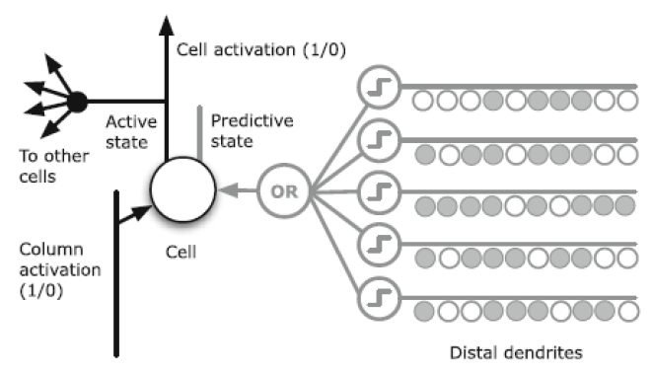
DDS (Distal Dendrite Segments)
A dendritic segment creates connections with cells that were active together at a previous period, allowing it to remember the activation state of nearby cells
If one of its segments encounters the same cellular activation pattern again, that is, if the number of active synapses on any segment exceeds a threshold, the cell will enter a predictive state, signalling that feed-forward input will likely result in column activation shortly
Feedforward input through the proximal dendrite or lateral connections through the distal dendrite segments keeps a cell active

Slide 7
Methodology
Multi Sequence Learning – Numbers
Multi Sequence Learning – Alphabets
Multi Sequence Learning – Image Data Sets

